Slide 1
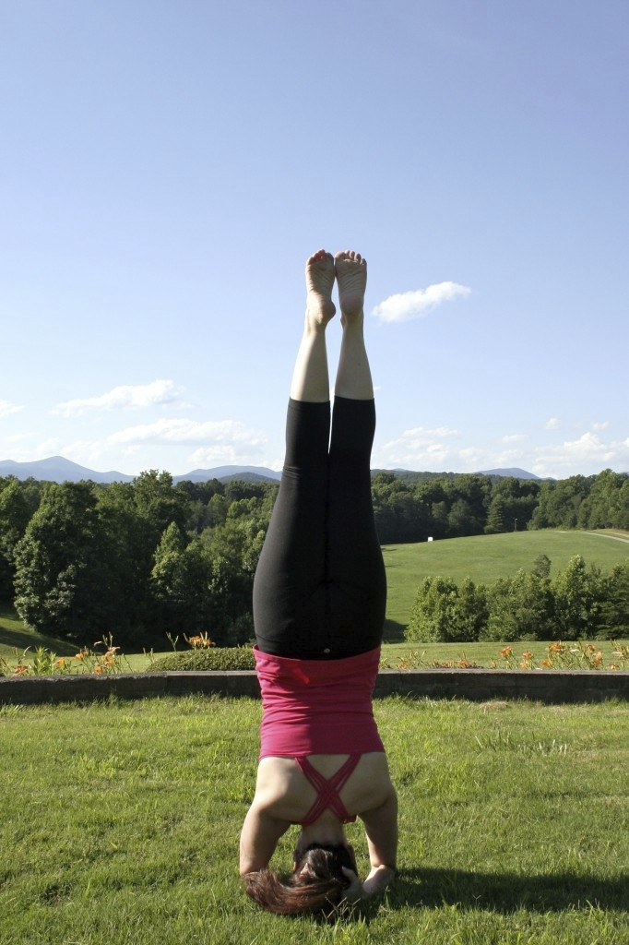
Yoga for Athletes
Day & Time
Scheduling is flexible. Choose from a regular weekly class, a series of 6, 8 or 10 weeks or integrate with a camp. Call me to discuss.
Location
At your school, gym, or facility
Pricing $10 per person per class (regular yoga classes can cost up to $20 per person per class) 7 athlete minimum
Coaches are welcome to join their teams at no cost!
Why? Anyone close to competitive athletics knows the body is challenged regularly and the mind must be focused in order to compete successfully and to prevent injury. Yoga is gaining popularity with many high level athletes as a way to rejuvenate the body, increase strength & flexibility, focus the mind and breath and to bring the body back into balance. This helps to prevent injuries and health issues both today and in the future. As a former competitive gymnast, diver, and cheerleader, Christy knows what athletes need in terms of core strength, flexibility, and mental control.
In addition, a recent study published in the Journal of Developmental & Behavioral Pediatrics, concluded that yoga may “serve a preventative role in adolescent mental health” by providing teens with beneficial ways to deal with stress and trauma.
Christy Newsome, E500RYT
Registered through Yoga Alliance at the highest level
Certified through Peachtree Yoga Center (200) & Etowah Valley Yoga (500)
Certified professional yoga therapist through Etowah Valley Yoga
Former Competitive Gymnast
Former Division 1 College Cheerleader (2nd place UCA Nationals)
Former Division 1 Diver
CPR-AED Certified ~ Insured
Phone: 678-469-3205
Email: KindHeartYoga@gmail.com Web: www.KindHeartYoga.com

